Slide 1
SWE 4803
Lec – 8

Slide 2
Monitoring and Controlling Process Group
The Monitoring and Controlling Process Group consists of those processes required to track, review, and regulate the progress and performance of the project; identify any areas in which changes to the plan are required; and initiate the corresponding changes..

Slide 3
Monitoring and Controlling Process Group
Activities:
Measure project performance
Verify and manage changes to the project
Ensure project deliverables conform to quality standards
Monitor all risks
Maintain Issue Log
Maintain Project Knowledge Repository
Monitor Procurement Activities

Slide 4
Monitoring and Controlling Process Group
Processes:
Validate Scope
Control Scope
Control Schedule
Control Cost
Control quality
Control Resources
Monitor Communications
Monitor risks
Control procurements
Monitor Stakeholder Engagement
Monitor and control Project works
Perform Integrated Change Control

Slide 5
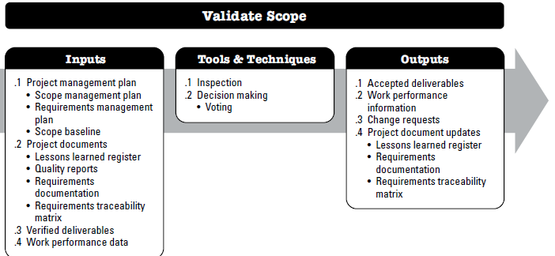
Validate Scope
is the process of formalizing acceptance of the completed project deliverables.
The key benefit of this process is that it brings objectivity to the acceptance process and increases the probability of final product, service, or result acceptance by validating each deliverable.

Slide 6
Validate Scope
Input:
Project management plan
    Scope management plan, Requirements management Plan, Scope baseline
Project documents
    Lessons learned register, Quality report, Requirements Documentation, Requirements traceability matrix
Verified Deliverables –
  Verified deliverables are project deliverables that are completed and checked for correctness through the Control Quality process.
Work performance data

Slide 7
Validate Scope
Tools & Techniques:
Inspection
Decision making

Slide 8
Validate Scope
Output:
Accepted deliverables
Work performance information
Change requests
Project Document updates
  Lessons learned register
  Requirements documentation
  Requirements traceability matrix

Slide 9
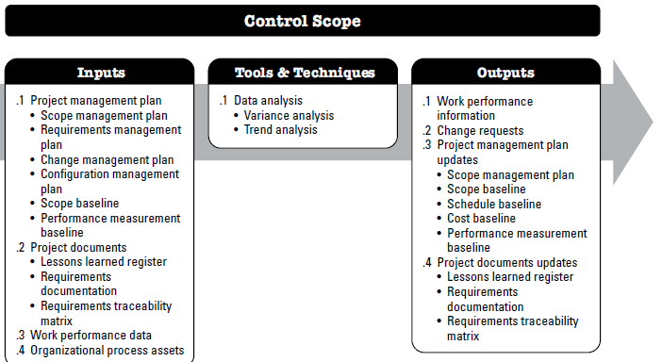
Control Scope
is the process of monitoring the status of the project and product scope and managing changes to the scope baseline.
The key benefit of this process is that the scope baseline is maintained throughout the project.

Slide 10
Important Idea
PMI does not allow gold plating (additional work)
Ensure only requested changes, corrective and preventive actions are processed through integrated change control Process
There is no uncontrolled scope change.

Slide 11
Control Scope
Input:
Project management plan
    Scope management plan, Requirements management Plan, Change management plan
Project documents
    Lessons learned register, Quality report, Requirements Documentation, Requirements traceability matrix
Work performance data
OPA

Slide 12
Control Scope
Tools & Techniques:
Data analysis

Slide 13
Control Scope
Output:
Performance (Planned vs Actual)
Change Requests - Variance analysis can result in changes
Project Document updates
  Lessons learned register
  Requirements documentation
  Requirements traceability matrix
PM Plan Update
  Scope management plan
  Scope baseline
  Schedule baseline
  Cost baseline
  Performance measurement baseline

Slide 14
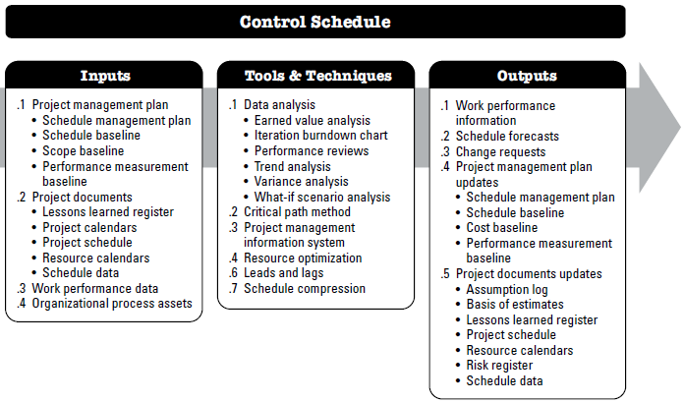
Control Schedule
is the process of monitoring the status of the project to update the project schedule and managing changes to the schedule baseline.
The key benefit of this process is that the schedule baseline is maintained throughout the project.

Slide 15
Control Schedule
Input:
Project management plan
    Schedule management plan, Schedule baseline, Scope baseline, Performance measurement baseline
Project documents
    Lessons learned register, Project calendars, Project schedule, Resource calendars, Schedule data
Work performance data
OPA

Slide 16
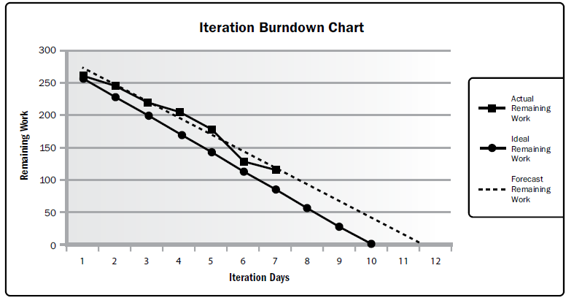
Control Schedule
Tools & Techniques:
Data Analysis
Critical path method
PMIS
Resource optimization
Leads and lags
Schedule compression

Slide 17
Control Schedule
Output:
Work performance information
Schedule forecasts
Change requests
PM Plan update
  Schedule baseline, Schedule management plan, Cost baseline
Project doc update
  Project data, Project schedule

Slide 18
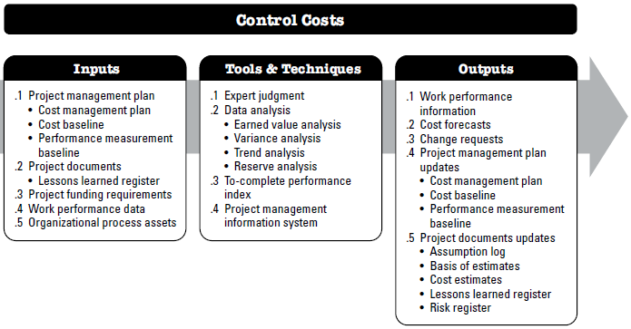
Control Cost
The process of monitoring the status of the project to update the project costs and manage changes to the cost baseline..

Slide 19
Control Cost
Input:
Project management plan
    Cost management plan, Cost baseline, Performance measurement baseline
Project documents
    Lessons learned register
Work Performance data – The information from performance reports and related forecasts assists in determining future team resource requirements, recognition and rewards, and updates to the resource management plan.
Project funding requirement
OPA
    Existing formal and informal cost control-related policies, procedures, and guidelines; Cost control tools; and Monitoring and reporting methods to be used.

Slide 20
Control Cost
Tools & Techniques:
Expert Judgement
Data analysis
  Earned value analysis
TCPI
  It is the Projected Future Cost Efficiency to complete the project within Approved Budget. CPI is the Actual Efficiency of the project till the Control Date whereas TCPI is the Projected Future Efficiency to complete the remaining work.
PIMS

Slide 21
Control Cost
Earned value analysis (EVA)
basic terms/values of EVA:
  Budget At Completion (BAC)
    is the Estimated (or Planned or Budgeted) Cost required to complete the Entire Work
  Planned Value (PV)
    Monetary Value of the Work that was Planned (Estimated) to be Completed by the Control Date.
  Earned Value (EV)
    Monetary Value of the Work that was Actually Completed by the Control Date. It is NOT the Cost of Work completed. Rather it is the value of the Work completed as per the original Budget.
  Actual Cost (AC)
    is the Cost of Work that was Actually Completed by the Control Date.

Slide 22
Control Cost
Earned value analysis (EVA)
  Schedule Variance (SV)
    is the difference between the monetary value of Work that was Actually Completed and the monetary value of Work that was Planned to be Completed. (SV) = EV – PV
  Cost Variance (CV)
    is the difference between the monetary value of Work that was Actually Completed and the Cost of Work that was Actually Completed. (CV) = EV – AC
  Schedule Performance Index (SPI)
    is the ratio of the monetary value of Work that was Actually Completed and the monetary value of Work that was Planned to be Completed. (SPI) = EV/PV
  Cost Performance Index (CPI)
    is the ratio of the monetary value of Work that was Actually Completed and the Cost of Work that was Actually Completed. (CPI) = EV/AC

Slide 23
Control Cost
Earned value analysis (EVA)
  Estimate To Complete (ETC)
    is the Estimated Cost of the Remaining Work (Work that is remaining on the Control Date). Or simply, it is the money required to complete the Remaining Work.
  Estimate At Completion (EAC)
    is the Revised Estimated Budget for the Entire Work. The Original Budget was estimated as BAC. But on the Control Date Project may have a Cost Variance (CV). Due to the Cost Variance, Original Budget (BAC) may no longer be valid. The original budget may need to be adjusted. EAC is the Adjusted (or Proposed or Revised) Budget.
  To Complete Performance Index (TCPI)
    is the Projected Future Cost Efficiency to complete the project within Approved Budget. CPI is the Actual Efficiency of the project till the Control Date whereas TCPI is the Projected Future Efficiency to complete the remaining work.

Slide 24
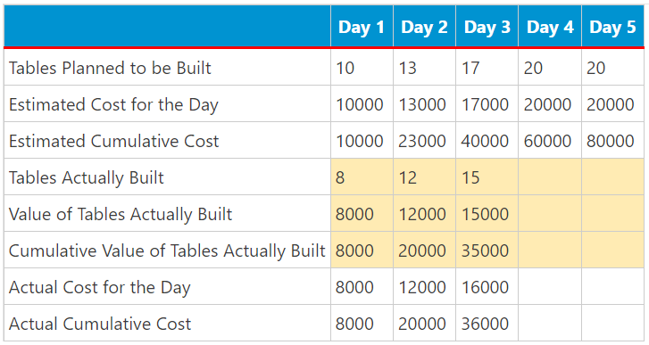
Control Cost
Earned value analysis (EVA)
The project team needs to build 80 wooden tables in 5 days. It is estimated that each table will cost 1000 units of money.
EV = 35 * 1000 = 35000
PV = 40 * 1000 = 40000
AC = 36000
What can we say:
The project is behind schedule. had planned to build 40 tables at the end of Day 3 but build 35 tables.
2. The project is Over Budget.
  36000 units of money was spent for doing the work that was worth 35000 units of money.

Slide 25
Control Cost
Earned value analysis (EVA)
Schedule Variance (SV) = EV – PV
Cost Variance (CV) = EV – AC
Schedule Performance Index (SPI) = EV/PV
Cost Performance Index (CPI) = EV/AC
SV = 35000 – 40000 = -5000
CV = 35000 – 36000 = -1000
SPI = 35000 / 40000 = 0.875
CPI = 35000 / 36000 = 0.97
Findings:
Negative variance means Project is behind. BAD
Positive variance means Project is ahead. GOOD
Performance Index less than 1 means Project is behind. BAD
Performance Index greater than 1 means Project is ahead. GOOD

Slide 26
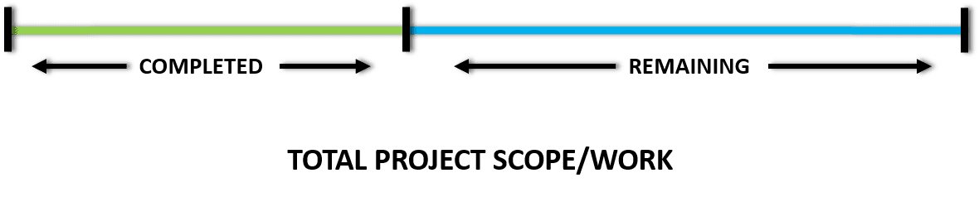
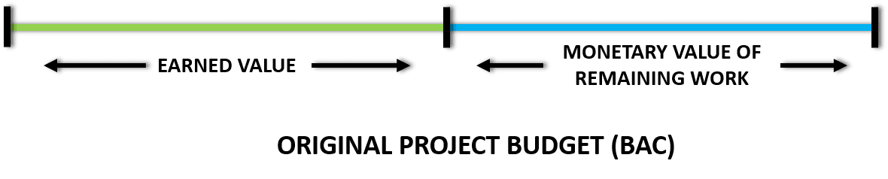
Control Cost
Estimate To Complete (ETC) Formulas
ETC is an estimated cost of remaining work.
Remaining Work = Total Work – Completed Work
next step is to find the MV of remaining work.
MV of Remaining Work = BAC – EV

Slide 27
Control Cost
Estimate To Complete (ETC)
BAC is 80000.
EV is 35000.
MV of the remaining work is 45000.
Actual Cost (AC) is 36000.
Now, we have to find the expected cost of performing work that is worth 45000 units of money.
we know that the work that was worth 35000 units of money was completed in 36000 units of money. So, mathematically (by using ratio and proportion), we can say that work that work that is worth 45000 units of money should require:
45000*36000/35000 or 46286 units of money.
EV/AC
ETC = (MV of remaining work)/(Cost Performance Index)

Slide 28
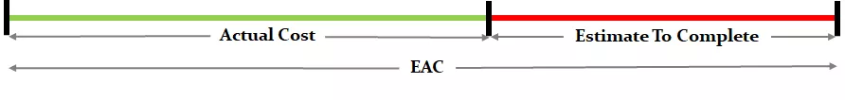
Control Cost
Estimate At Completion (EAC)
Estimate At Completion is the revised estimate of the total funds required to complete total work of a project…
The expected total cost of completing all work expressed as the sum of the actual cost to date and the estimate to complete.
EAC = (Actual Expenditure Till Date) + (Estimated Future Expenditure)
EAC = AC + ETC
EAC = 36000 + 46286 = 82286

Slide 29
Control Cost
To Complete Performance Index (TCPI)
To Complete Performance Index (TCPI) is the estimated cost efficiency required to complete the remaining project work within the defined budget.
Let’s assume that you are running a full marathon of 42 km. Before starting the race, you had set yourself a target of 4 hours for finishing the race. After running for 2 hours, you realize that you have completed only 18 km, which is less that 50% of the full distance.
You still want to meet your target of 4 hours. How will you do it?
You will, obviously, increase your speed to complete the race in the defined time limit.
In other words, you will cover the remaining distance (24 km) in the remaining time (2 Hrs).
The future (increased) cost efficiency to complete the project within the defined budget is called To Complete Performance Index (TCPI).

Slide 30
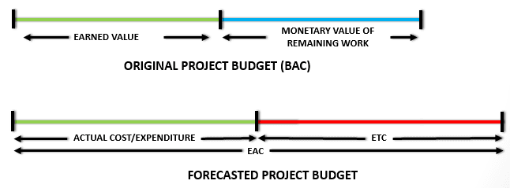
Control Cost
To Complete Performance Index (TCPI)
TCPI = (monetary value of remaining work)/(remaining funds)
Numerator
monetary value of remaining work = monetary value of total work – monetary value of completed work
monetary value of remaining work = BAC – EV
Denominator
remaining funds = total project budget – actual expenditure
remaining funds = total project budget – AC
Final Equation
TCPI = (BAC – EV) / (BAC – AC)

Slide 31
Control Cost
To Complete Performance Index (TCPI)
BAC is 80000.
EV is 35000.
Actual Cost (AC) is 36000.
If the project has to be completed within the original budget (BAC), then we can replace total project budget with BAC.
TCPI_{E} = (BAC – EV) / (BAC – AC)
TCPI_{B} = (80000 – 35000) / (80000 – 36000) = 1.02
If the project has to be completed within the revised budget (EAC), then we can replace total project budget in the Generic Equation with EAC. The equation reduces to:
TCPI_{E} = (BAC – EV) / (EAC – AC)
Consider Sponsor has imposed a revised budget (EAC) of 78000
TCPI_{E} = (80000 – 35000) / (78000 – 36000) = 1.07

Slide 32
Control Cost
To Complete Performance Index (TCPI)
TCPI < 1 – it means that project has more funds and less work. It is easier to complete the project.
TCPI = 1 – it means that project has just enough funds to complete the work.
TCPI > 1 – it means that project has less funds and more work. It is difficult to complete the project.
Difference Between CPI And TCPI
CPI = (monetary value of completed work)/(expenditure till control date)
TCPI = (monetary value of remaining work)/(remaining funds)
CPI < 1 – it means that earned value is less than the money spent. BAD
CPI = 1 – it means that earned value is equal to the money spent.
CPI > 1 – it means that earned value is more than the money spent. GOOD

Slide 33
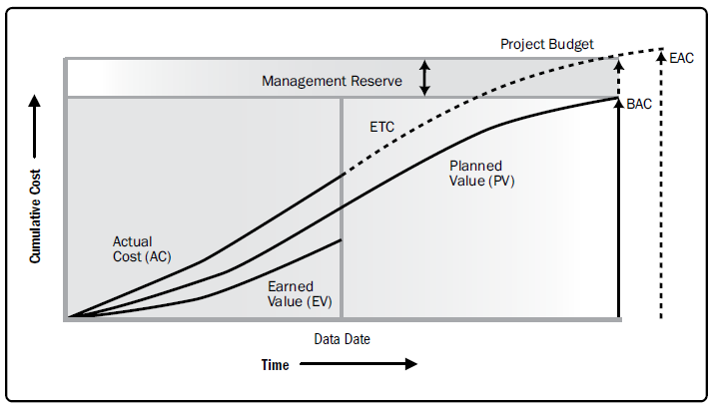
Control Cost

Slide 34
Quiz
When you collect the earned value data for your project, you get the following data:
PV = $1,500,000, EV = $ 1,200,000, AC = $1,000,000. You expect the factors for cost variance to continue in the same way in future. The value of the remaining work is $1,000,000. What should be the new EAC for the project?
Solution:
EAC = AC + ETC
CPI = EV/AC = 1,200,000/1,000,000 = 1.2.
ETC = (MV of remaining work)/(CPI)
= 1000000 / 1.2 = 8333333.33
EAC = AC + ETC = 1,000,000 + 8333333 = 18333333.33

Slide 35
Control Cost
Output:
Work performance information
  SV, SPI, CV, CPI of WBS element
Cost forecasts
  EAC
Project management plan Updates
  Cost performance baseline, Cost management plan
Project documents updates
  Cost estimates, basis of estimates
Change Request

Slide 36
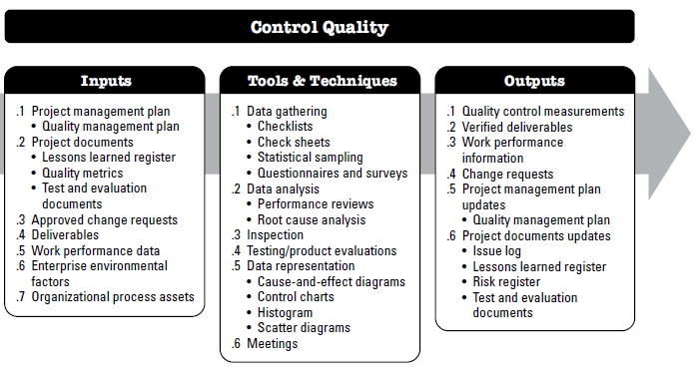
Control Quality
The process of monitoring and recording the results of executing the quality management activities to assess performance and ensure the project outputs are complete, correct, and meet customer expectations.

Slide 37
Control Quality
Input:
Project management plan
    Quality management plan
Project documents
    Lessons learned register, Quality metrics, est and evaluation
    documents
Work performance data
Approved change request
Deliverables
EEF &OPA

Slide 38
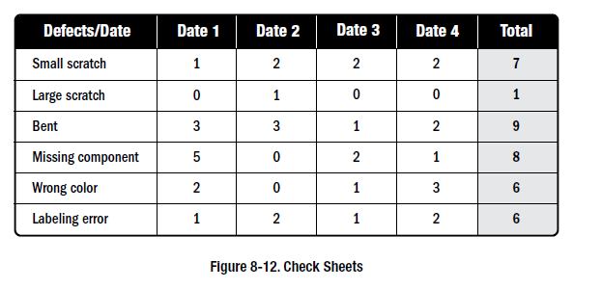
Control Quality
Tools & Techniques:
Data gathering –Checklists, Check sheets, Statistical sampling, Questionnaires and surveys
Data Analysis
Inspection
Testing /product evaluation
Data Representation - Cause-and-effect diagrams, Control charts, Pareto Chart,Histogram, Scatter diagrams
Meetings
Control limit are set by project manager and appropriate stakeholders to reflect point where corrective action will be taken to avoid exceeding specification limit

Slide 39
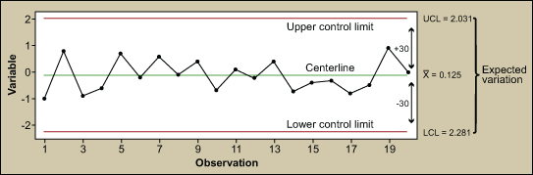
Control Quality
Tools & Techniques:
Data gathering –Checklists, Check sheets, Statistical sampling, Questionnaires and surveys
Data Analysis
Inspection
Testing /product evaluation
Data Representation - Cause-and-effect diagrams, Control charts, Pareto Chart,Histogram, Scatter diagrams
Meetings
Control limit are set by project manager and appropriate stakeholders to reflect point where corrective action will be taken to avoid exceeding specification limit

Slide 40
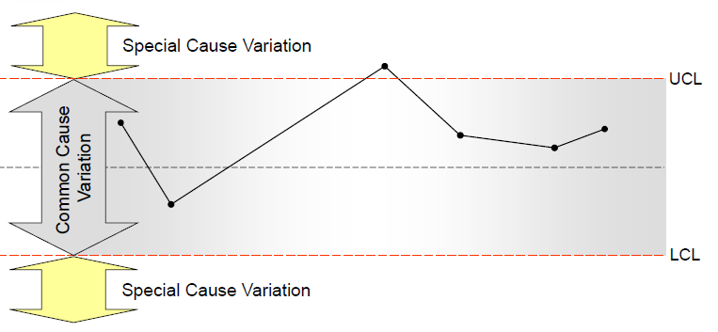
Control Quality
Tools & Techniques:
Data gathering –Checklists, Check sheets, Statistical sampling, Questionnaires and surveys
Data Analysis
Inspection
Testing /product evaluation
Data Representation - Cause-and-effect diagrams, Control charts, Pareto Chart,Histogram, Scatter diagrams
Meetings
Control limit are set by project manager and appropriate stakeholders to reflect point where corrective action will be taken to avoid exceeding specification limit

Slide 41
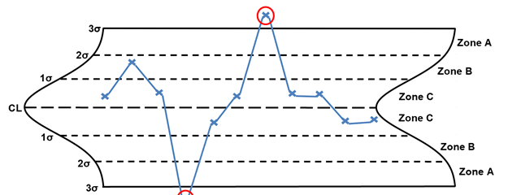
Control Quality
Statistical Process Control charts :
Rules
Rule 1 – One point beyond the 3 σ control limit
Rule 2 – Eight or more points on one side of the centerline without crossing
Rule 3 – Four out of five points in zone B or beyond
Rule 4 – Six points or more in a row steadily increasing or decreasing
Rule 5 – Two out of three points in zone A
Rule 6 – 14 points in a row alternating up and down
Rule 7 – Any noticeable/predictable pattern, cycle, or trend

Slide 42
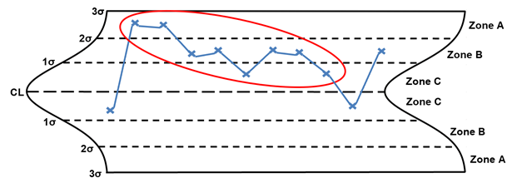
Control Quality
Statistical Process Control charts :
Rules
Rule 1 – One point beyond the 3 σ control limit
Rule 2 – Eight or more points on one side of the centerline without crossing
Rule 3 – Four out of five points in zone B or beyond
Rule 4 – Six points or more in a row steadily increasing or decreasing
Rule 5 – Two out of three points in zone A
Rule 6 – 14 points in a row alternating up and down
Rule 7 – Any noticeable/predictable pattern, cycle, or trend

Slide 43
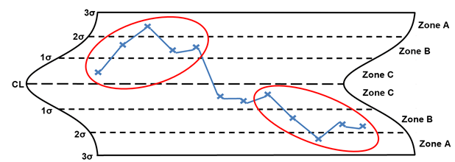
Control Quality
Statistical Process Control charts :
Rules
Rule 1 – One point beyond the 3 σ control limit
Rule 2 – Eight or more points on one side of the centerline without crossing
Rule 3 – Four out of five points in zone B or beyond
Rule 4 – Six points or more in a row steadily increasing or decreasing
Rule 5 – Two out of three points in zone A
Rule 6 – 14 points in a row alternating up and down
Rule 7 – Any noticeable/predictable pattern, cycle, or trend

Slide 44
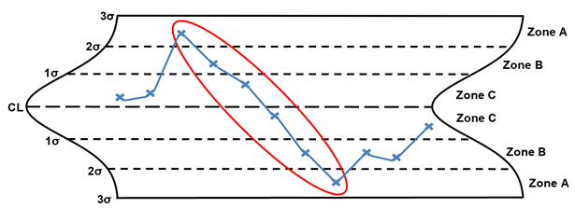
Control Quality
Statistical Process Control charts :
Rules
Rule 1 – One point beyond the 3 σ control limit
Rule 2 – Eight or more points on one side of the centerline without crossing
Rule 3 – Four out of five points in zone B or beyond
Rule 4 – Six points or more in a row steadily increasing or decreasing
Rule 5 – Two out of three points in zone A
Rule 6 – 14 points in a row alternating up and down
Rule 7 – Any noticeable/predictable pattern, cycle, or trend

Slide 45
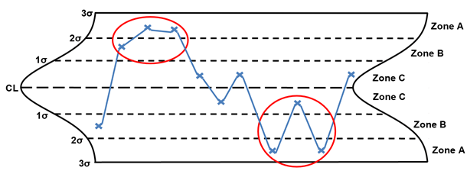
Control Quality
Statistical Process Control charts :
Rules
Rule 1 – One point beyond the 3 σ control limit
Rule 2 – Eight or more points on one side of the centerline without crossing
Rule 3 – Four out of five points in zone B or beyond
Rule 4 – Six points or more in a row steadily increasing or decreasing
Rule 5 – Two out of three points in zone A
Rule 6 – 14 points in a row alternating up and down
Rule 7 – Any noticeable/predictable pattern, cycle, or trend

Slide 46
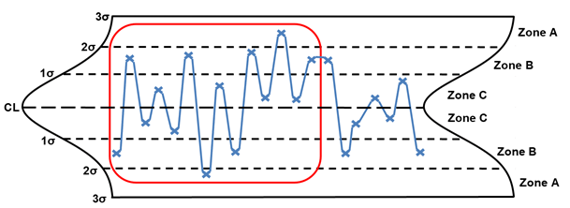
Control Quality
Statistical Process Control charts :
Rules
Rule 1 – One point beyond the 3 σ control limit
Rule 2 – Eight or more points on one side of the centerline without crossing
Rule 3 – Four out of five points in zone B or beyond
Rule 4 – Six points or more in a row steadily increasing or decreasing
Rule 5 – Two out of three points in zone A
Rule 6 – 14 points in a row alternating up and down
Rule 7 – Any noticeable/predictable pattern, cycle, or trend

Slide 47
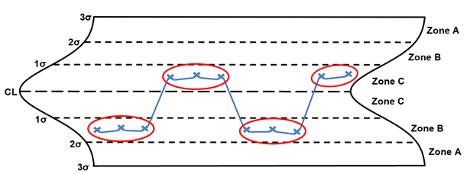
Control Quality
Statistical Process Control charts :
Rules
Rule 1 – One point beyond the 3 σ control limit
Rule 2 – Eight or more points on one side of the centerline without crossing
Rule 3 – Four out of five points in zone B or beyond
Rule 4 – Six points or more in a row steadily increasing or decreasing
Rule 5 – Two out of three points in zone A
Rule 6 – 14 points in a row alternating up and down
Rule 7 – Any noticeable/predictable pattern, cycle, or trend

Slide 48
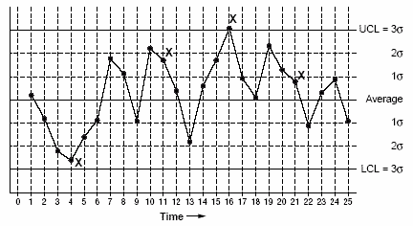
Control Quality
Statistical Process Control charts :
Out of control signals
A single point outside the control limits. point 16 is above the UCL (upper control limit).
Two out of three successive points are on the same side of the centerline and farther than 2 σ from it. point 4 sends that signal.
Four out of five successive points are on the same side of the centerline and farther than 1 σ from it. point 11 sends that signal.
A run of eight in a row are on the same side of the centerline. Or 10 out of 11, 12 out of 14, or 16 out of 20. point 21 is eighth in a row above the centerline.

Slide 49
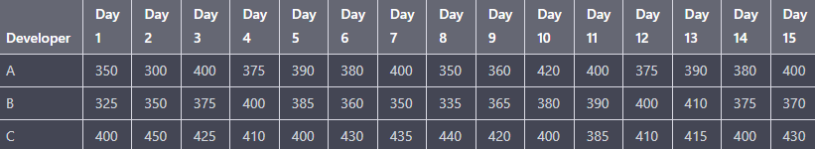
Control Quality
Assume that a software development team has three developers working on a project, and the team leader wants to monitor the number of lines of code (LOC) written by each developer over a 15-day period to ensure that they are meeting the project's coding standards.
Create control charts to monitor the number of LOC written by each developer over the 15 days and identify the out-of-control signals (if any)?

Slide 50
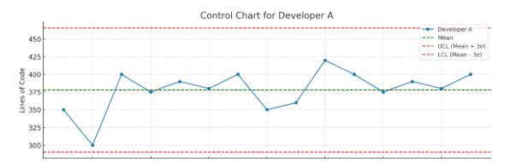

Slide 51
Control Quality
Pareto Principle :
The Pareto Principle, also known as the 80/20 rule
Roughly 80% of effects come from 20% of the causes.
A small number of causes are often responsible for a large portion of the result. It’s used to identify the vital few problems that cause the majority of issues.
In Software Development:
  80% of bugs might come from 20% of the modules.
  80% of user complaints might be due to 20% of the features.

Slide 52
Control Quality
How Pareto is Related to Quality Control:
The Pareto Principle helps identify the few key causes (the vital 20%) that are responsible for most of the defects (the trivial 80%).
Using a Pareto chart, a team can target high-impact areas first, ensuring that quality improvements are cost-effective.
Quality managers can see which specific defect types or sources are dominating and take action accordingly.
Example in Software Quality:
Suppose a software team tracks bug reports and finds:
  30% bugs in login module
  25% bugs in payment system
  5% bugs in UI
  3% bug in Inventory module
  Rest scattered in other modules
The Pareto chart suggests focusing on the login and payment modules to fix most defects and boost quality quickly.

Slide 53
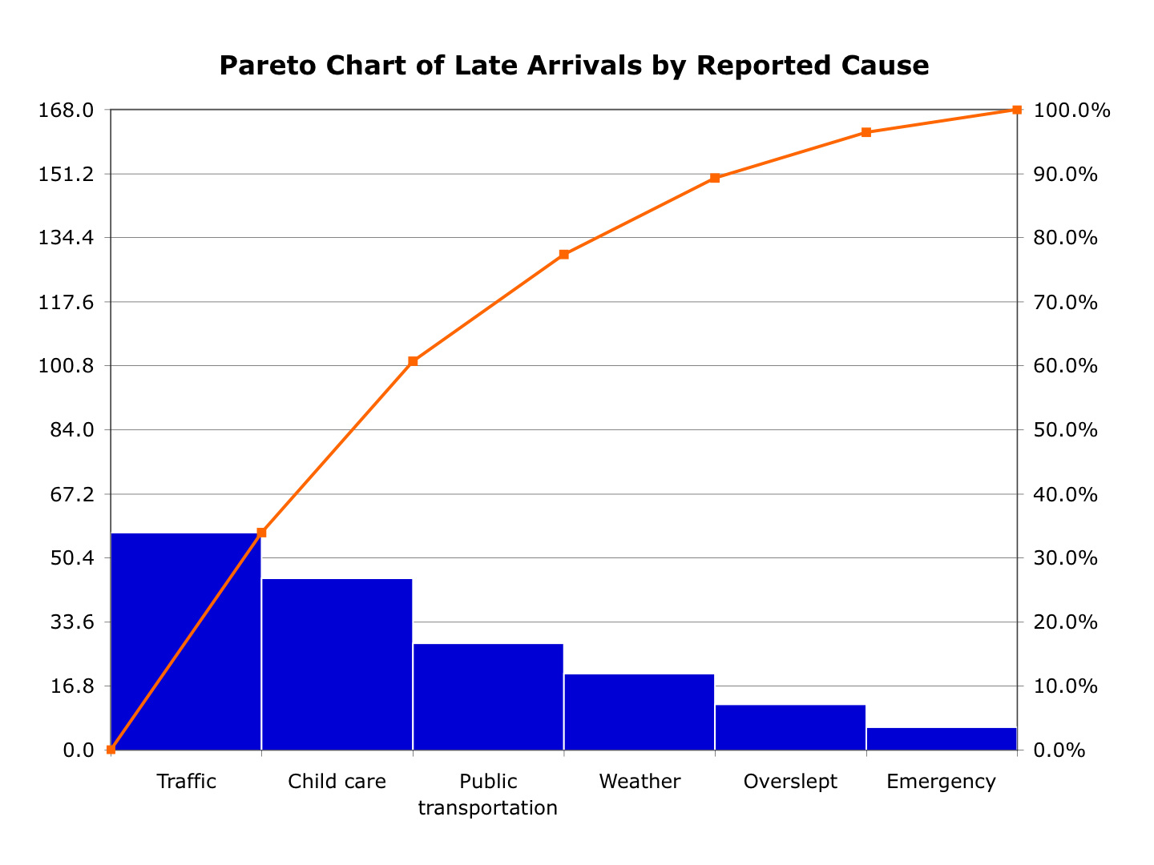
Control Quality
Pareto charts :
A Pareto chart is a bar graph or the combination of bar and line graphs.
individual values are represented in descending order by bars, and the cumulative total is represented by the line.

Slide 54
Control Quality
The team has collected data on the number of bugs in each category and wants to identify the most significant factors.
Category | Number of Bugs
Null Pointer Exceptions | 25
Memory Leak | 15
Incorrect algo. implementation | 10
Input validation error | 5
UI bugs | 4
others | 1

Slide 55
Control Quality
Output:
Quality control measurements
Verified deliverables
Work Performance Information
Change request
PM Plan update
  Quality management plan, process improvement plan
Project doc update
  Issue log, LL register, risk register

Slide 56
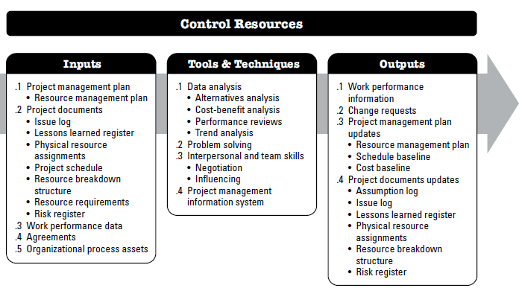
Control Resources
The process of ensuring that the physical resources assigned and allocated to the project are available as planned, as well as monitoring the planned versus actual use of resources, and performing corrective action as necessary.

Slide 57
Control Resources
Input:
Project management plan
    Resource management plan
Project documents
    Issue log, Lessons learned register, Physical resource Assignments, Project schedule, Resource breakdown structure, Resource requirements, Risk register
Work performance data
Agreements
OPA

Slide 58
Control Resources
Tools & Techniques:
Data Analysis
Problem solving
Interpersonal and team skills
PMIS

Slide 59
Control Resources
Things to do:
Monitor Resource Usage
    This involves tracking how resources are being used, how much is being used, and whether it is in line with the project plan.
Compare Actual Resource Usage to the Plan
    This involves comparing actual resource usage to the resource baseline established during the planning phase of the project.
Analyze Variances
    This involves identifying the cause of the variance, determining its impact on the project, and assessing whether corrective action is necessary.
Take Corrective Action
    This may involve reallocating resources, adjusting the project plan, or revising the resource baseline.

Slide 60
Control Resources
Output:
Work Performance Information
Change request
PM Plan update
  Resource management plan, Schedule baseline, Cost baseline
Project doc update
  Issue log, LL register, risk register, Resource breakdown structure, Assumption log, Physical resource assignments

Slide 61
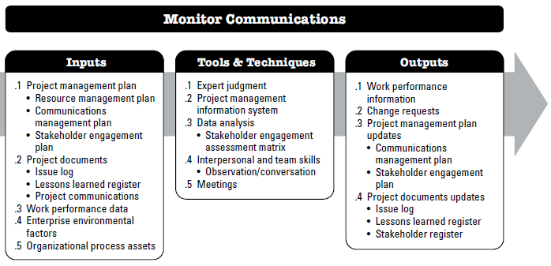
Monitor Communications
Monitor Communications is the process of ensuring the information needs of the project and its stakeholders are met..

Slide 62
Monitor Communications
Input:
Project management plan
    Resource management plan, Communications management plan, Stakeholder engagement plan,
Project documents
    Issue log, Lessons learned register, Project Communications
Work performance data
EEF & OPA

Slide 63
Monitor Communications
Tools & Techniques:
Expert Judgement
Data Analysis
Interpersonal and team skills - Observation/conversation
PMIS
Meetings

Slide 64
Monitor Communications
Things to do:
Monitor Communication Performance
ensure that information is being shared effectively and efficiently. This involves tracking the frequency and quality of communication, identifying any communication gaps or issues, and taking corrective action as necessary.
Evaluate the Effectiveness of Communication
evaluate the effectiveness of the communication processes to determine whether they are meeting the needs of stakeholders. This involves collecting feedback from stakeholders and using this information to make improvements to the communication processes.
Adjust Communication Processes as Needed
adjust the communication processes as needed to ensure that information is shared effectively and efficiently among stakeholders. This may include revising communication plans, adjusting communication channels, or providing additional training to team members.

Slide 65
Monitor Communications
Output:
Work Performance Information
Change request
PM Plan update
  Communications management plan, Stakeholder engagement plan
Project doc update
  Issue log, LL register, risk register, Stakeholder register

Slide 66
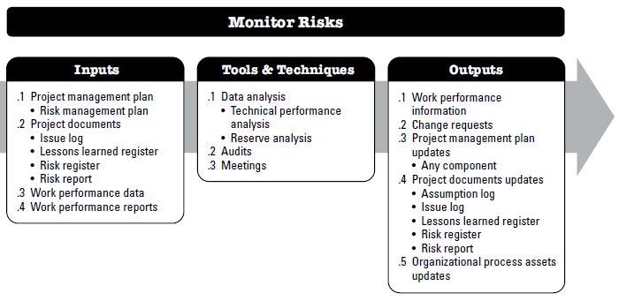
Monitor Risk
is the process of monitoring the implementation of agreed-upon risk response plans, tracking identified risks, identifying and analyzing new risks, and evaluating risk process effectiveness throughout the project.

Slide 67
Monitor Risk
Input:
Project management plan
    Risk management plan
Project documents
    Issue log, Lessons learned register, Risk register, Risk report
Work performance data
Work performance report - variance analysis, earned value data, and
forecasting data.

Slide 68
Monitor Risk
Tools & Techniques:
Data Analysis
Audits
Meetings

Slide 69
Monitor Risk
Output:
Work Performance Information
Change request
PM Plan update
  Any components
Project doc update
  LL register, risk register, Risk report
OPA updates

Slide 70
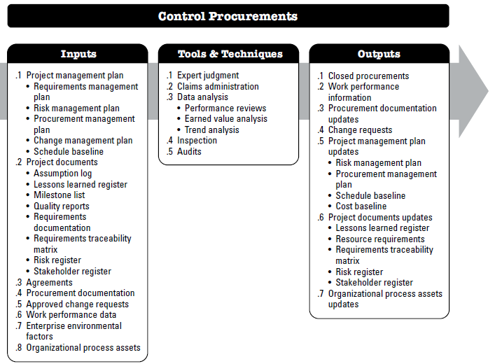
Control procurement
is the process of managing procurement relationships; monitoring contract performance and making changes and corrections as appropriate; and closing out contracts.

Slide 71
Control procurement
Input:
Project management plan
    Requirements management Plan, Risk management plan, Procurement management Plan, Change management plan, Schedule baseline
    Issue log, Lessons learned register, Risk register, Risk report
Work performance data
Work performance report - variance analysis, earned value data, and
forecasting data.

Slide 72
Control procurement
Tools & Techniques:
Data Analysis
Audits
Meetings

Slide 73
Control procurement
Output:
Work Performance Information
Change request
PM Plan update
  Any components
Project doc update
  LL register, risk register, Risk report
OPA updates

Slide 74
Quiz #3
Evaluation Rubrics:
Criteria | Description | Marks
Clarity of Research Goal and Scope | How well the team defined the problem, objective, and boundaries of the study. | 10
Understanding of Methodology and Dataset | Demonstrates depth of understanding of the methods used and dataset utilized. | 20
Interpretation and Explanation of Results | Results are presented clearly, with logical analysis and valid conclusions. | 20
Presentation Design and Slide Organization | Slides are neat, consistent, readable, and support the flow of presentation. | 30
Presenter’s Preparation and Delivery | Presenter is confident, well-practiced, and represents the team's work well. | 20

